Slide 1

# Career Catalyst 2025
Unlock Your Potential, Shape Your Future

Slide 2


Strategic Objectives & Target Audience
Enhance Career Awareness
Expand students' understanding of diverse career paths and industry opportunities beyond their academic focus.
Develop Essential Soft Skills
Cultivate critical communication, teamwork, and problem-solving abilities vital for professional success.
Bridge Academia-Industry Gap
Provide practical insights and tools to align academic knowledge with current industry expectations and demands.
Who We're Reaching
ABES Students (UG & PG)
All streams and programs are invited to participate.
Focus on 2nd and 3rd Year
Students seeking crucial early career awareness and skill development.

Slide 3
Full-Day Immersion: Session Flow
A dynamic, action-oriented schedule designed to maximize learning and engagement from start to finish.
09:30 – 10:00: Registration & Welcome
Efficient desk check-in, material distribution, and initial networking over coffee.
10:00 – 10:30: Keynote Address
Inspirational talk from a leading industry expert setting the stage for the day.
10:30 – 11:30: Soft Skills Workshop
Interactive session focusing on vital professional communication and collaboration techniques.
11:30 – 12:00: Coffee Break
Dedicated networking time to connect with peers and speakers.
12:00 – 13:00: Career Awareness Panel
Insightful discussion featuring successful alumni sharing their journey and advice.
13:00 – 14:00: Lunch Break
Refueling and continued informal networking.
14:00 – 15:00: Resume & LinkedIn Workshop
Hands-on guidance for building a compelling professional profile and digital presence.
15:00 – 16:00: Mock Interviews
Practical interview simulation and personalized feedback from industry volunteers.
16:00 – 16:30: Q&A & Wrap-Up
Open discussion to address final questions and summarize key takeaways.
16:30 – 17:00: Certificate Distribution
Formal acknowledgment of participation and closing remarks.

Slide 4

Operational Blueprint: Team & Logistics
Key Team Roles
Logistics Essentials
A focused team structure ensures every aspect of the event is managed efficiently.
Venue: The spacious and accessible ABES Auditorium.
Equipment: High-quality projector, professional sound system (mic), whiteboard, and flip charts for interactive sessions.
Event Coordinator
Ultimate oversight for execution and decision-making.
Materials: Comprehensive handouts, dedicated notepads, pens, and personalized name tags for attendees.
Refreshments: Consistent supply of tea, coffee, and snacks, culminating in a satisfying lunch break.
Session Leads
Responsible for content delivery and workshop quality.
Logistics Team
Handling venue setup, seating, and equipment readiness.
Registration Desk Team
Managing check-in, welcome, and material distribution.
Marketing Team
Driving promotions, student outreach, and communication.

Slide 5






Budget & Sponsorship Strategy
Venue & Equipment
Refreshments & Lunch
INR 20,000 for hall reservation and technical rentals.
INR 25,000 — Largest single expense ensuring a comfortable experience.
Total: 60,000
Workshop Materials
INR 5,000 for printing handouts and necessary supplies.
Certificates & Misc.
Marketing & Promotion
INR 5,000 covering certificates, speaker gifts, and contingencies.
INR 5,000 for digital and print advertisement costs.
Potential Sponsorship Pathways
Target local IT/tech companies for industry relevance, major Educational platforms (Coursera, LinkedIn Learning) for content partnership, and Stationery/event supply brands for material contribution.

Slide 6

Measuring Success: Impact & Metrics
Expected Transformational Impact
Key Success Metrics
Improved Career Clarity: Students gain confidence and direction for future decision-making.
150+
80%
Enhanced Skill Set: Tangible improvement in communication, teamwork, and core interview skills.
Target Attendance
Satisfaction Rate
A high turnout signifies broad student interest and event reach.
Goal for positive feedback via post-event surveys.
Increased Employability: Students are better prepared and more confident entering the job market.
100%
3X
Resume Reviews
Engagement Boost
Maximizing one-on-one practical guidance sessions.
Targeted increase in social media engagement and follow-up activities.

Slide 7

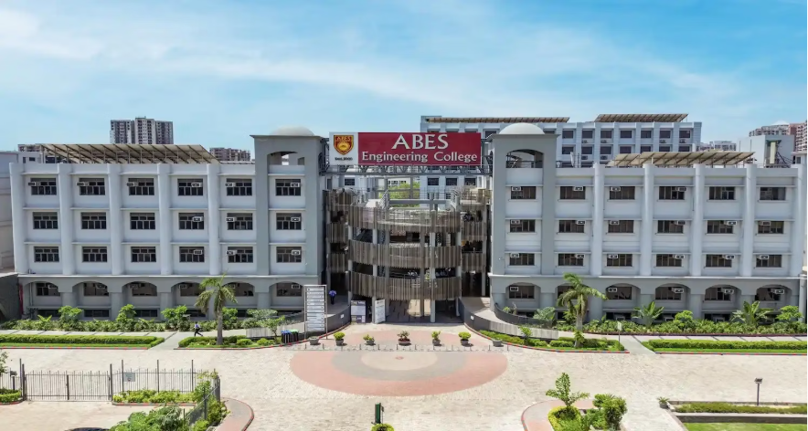
Thank You!
We look forward to seeing our students thrive.
Event Coordinator Contact:
Dr. [Event Coordinator Name]
Email: webadmin@abes.ac.in
Phone: +91-120-7135112, +91-120-7135113
Address: 19th KM Stone, NH-24, Delhi-Hapur Bypass Road, Ghaziabad - 201009, Uttar Pradesh, India
Website: www.abes.ac.in
Investing in your professional journey.

